Slide 1

The Magic Square
Abdulmohseen Ali Al-Ali
2020XXXXX
Ali Zakarla Al-Qutayfi
2020XXXXXX
Section: 3
Dr. Yahya Garout

Slide 2
The Description
The magic square is a square array of positive integers in which the sums of the numbers in each row, each column, and both main diagonals are the same.
The magic square which is used in this project is a 3X3 square, and the sums should equal 15.
The way to play is to press the button to increase it by 1 until reaching the target then do the same for the rest of the buttons, and the game ends when reaching the magic square.
It is possible to empty the button using the right-click.

Slide 3
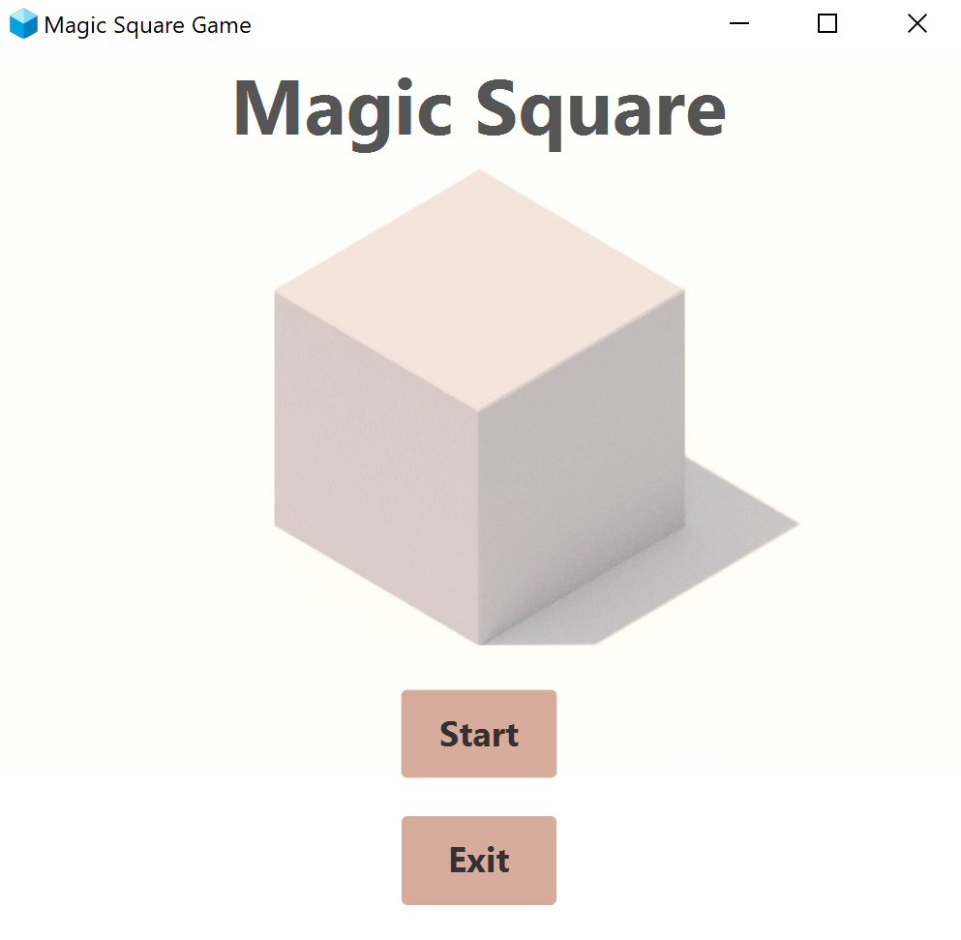
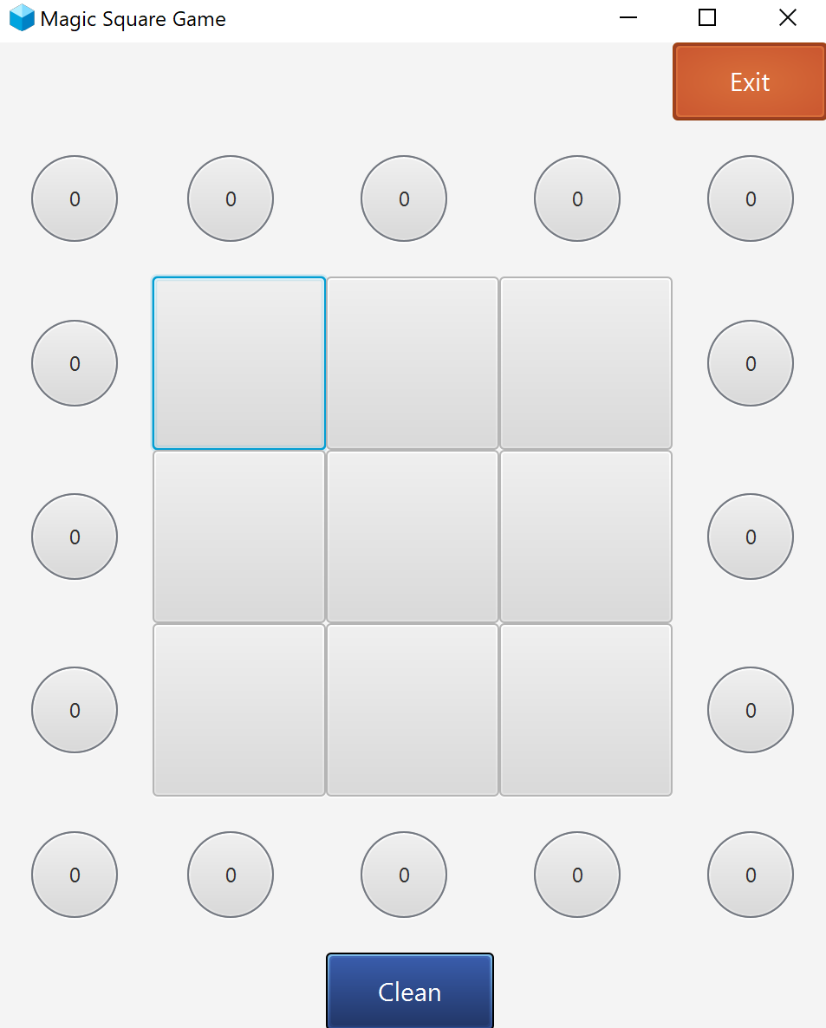
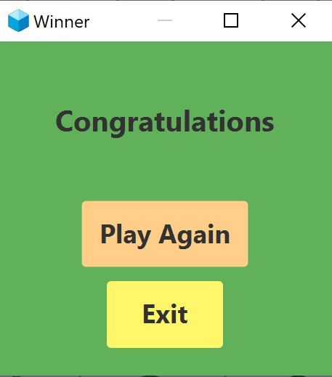
The Solution Description
The project consists of three parts:
Home Page scene.
Game scene.
Pop up page stage & scene.

Slide 4
Home Page Scene
We use a grid pane to arrange the components inside the scene, and it consists of four parts:
Title of the game.
Square image.
Start button: It changes the current stage scene to the game page scene using setScene() method.
Exit button: It closes the whole program using close() method.

Slide 5
Game Scene
We use a grid pane to arrange the components inside the scene, and it consists of three parts:
Filling boxes.
Result circles.
Exit and clean buttons.

Slide 6
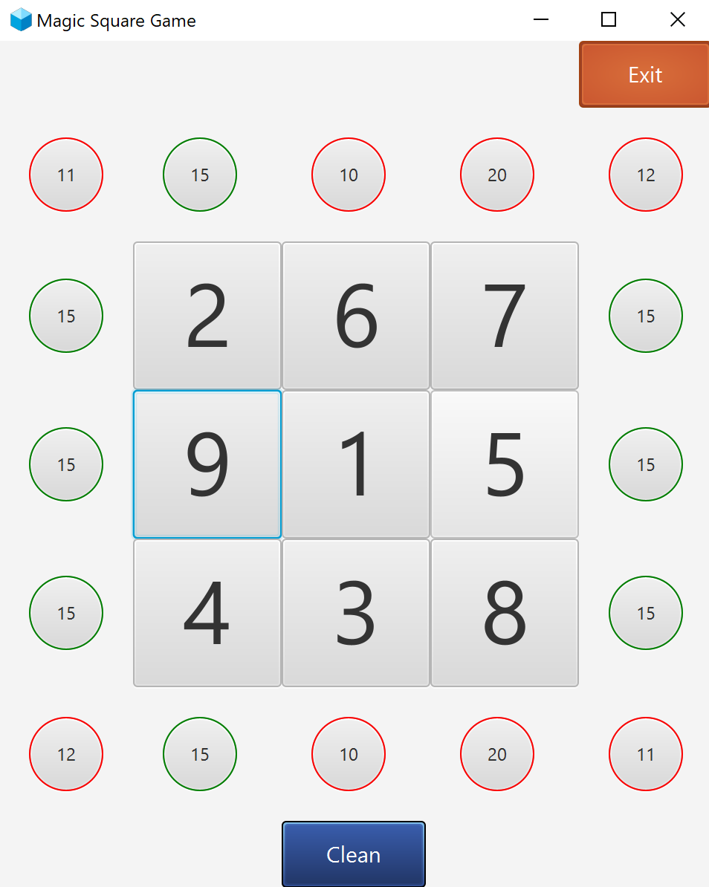
- Filling Boxes
It consists of an array that has 9 buttons. Each button can have a number from 1 to 9 without any duplication and that is done by using an arrayList with increaseButtonNumber() function and each time a button is pressed it will check whether the number is used or not. If the number is not used it will set the number to the box and if it is used it will move to the next number.
The user have the ability to empty the box using the right-click button which will apply setToEmpty() function to the box.

Slide 7
- Result Circles
It consists of an array that has 16 button. The functionality of these circles is to show the sums of each column, row and diagonal.
Each time a filling button is pressed the resultCircleValues() function will be applied and it will update the text of all circles to the sum of the related filling boxes values.
The border color of each circle will be changed according to the value inside it. If the sum is 15 it will be green else it will be red.

Slide 8
- Exit & Clean Buttons
Exit button: It closes the whole program using close() method.
Clean button: It set the filling boxes and the result circles to the default value by removing all the elements of the arrayList that is used to fill the boxes then it will apply the resultCirculeValues() function which will set the result circles to the default value then we use for loop to change the color of the border to the default.

Slide 9
Pop Up
Every time a filling box is pressed the the program will check the values of the result circles and if all of them equal 15 it will show the congratulations page by calling display method from the pop up class.
It consists of three parts:
Title.
Play again button: It will close the pop up page and apply the function display() which displays the pop up and return true then it will check if it is true it will do the same as clean button.
Exit button: It will close the pop up page and check if the return value of display method is false it will close the game page.

Slide 10
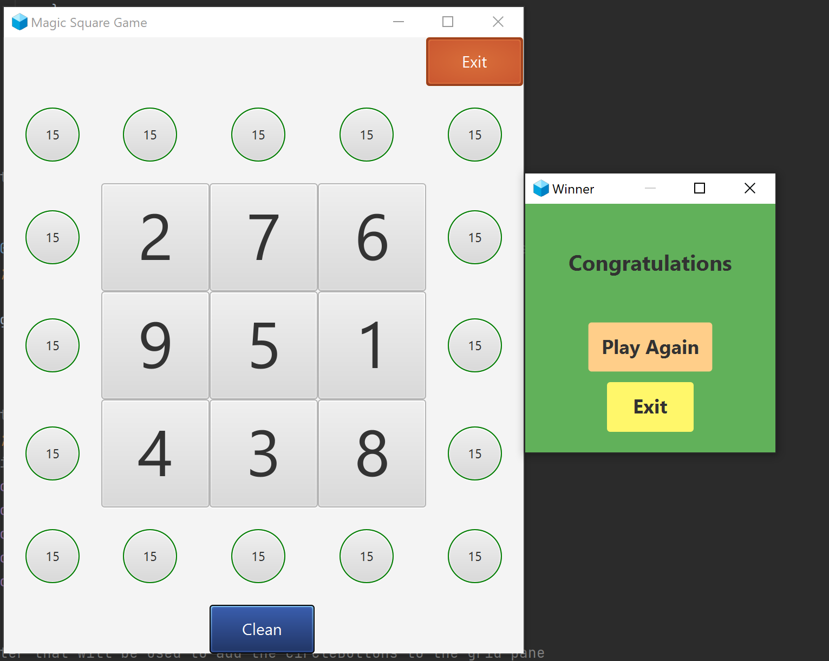
All Cases

Slide 11
Work Distribution
Abdulmohseen
Ali
Circles Buttons
Home page
Preventing the duplicate in the numbers
Result circle border color
Filling Boxes
The check for displaying the pop up page
Handle for exceeding number 9
Clean button
Increasing number by click
Writing the report
Pop-Up Class
Delete by right-click
All the CSS styles
Play Again & Exit buttons
Program Icon

